Slide 1
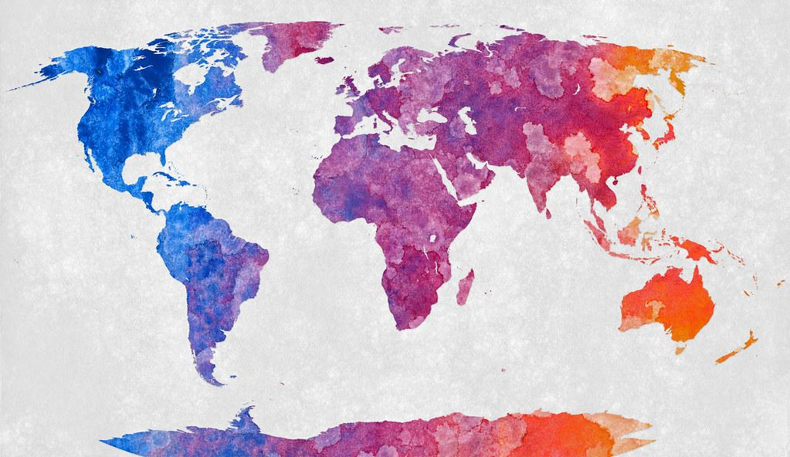
Climate Change Data Analysis
for 2000-2013 in Lagos, Nigeria; Montreal, Canada ; and Shanghai, China
Team 6: Alison Cook, Michael Fischer, Rafael Silva-Almodovar, Kelli Magsig

Slide 2

Purpose: Data selected in an effort to learn degree of global warming (°C) based on latitude
Reviewing Kaggle Dataset for Climate Change: Earth Surface Temperature, and Eighty years of Canadian climate data to predict climate changes for 3 major cities (Lagos, Montreal, and Shanghai)
Questions:
1- Will the 2000-2013 weather trends indicate an increase in Earth surface temperature for Lagos, Nigeria; Shanghai, China and Montreal, Canada?
2- What are the global increases in average temperature over time?
3- Do major cities impact climate change heavier?
4- Does relation to the equator have an effect?
5- What model would best predict future climate change?
Steps for exploring data:
1- Cleaning the datasets to remove years prior to 1900 then narrowing down from 2000-2013, dropping NaN, filtered for Northern Hemispheres and further broken down by 3 cities data only.
2- Splitting data into tables using SQLalchemy/PgAdmin.
3- Supervised machine learning models with process (load data and drop unnecessary columns), train (75% data), test (25% data), predict and include results ( r-squared 99%) and linear regression and random forest classifier (MAE, MSE)
4- Visualization answering questions with maps and graphical support

Slide 3
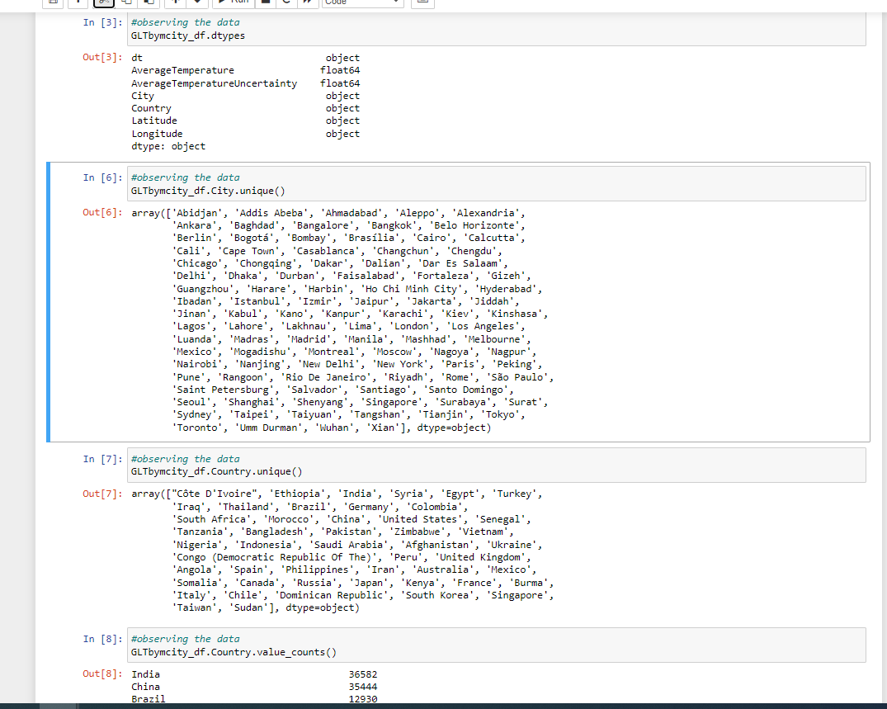
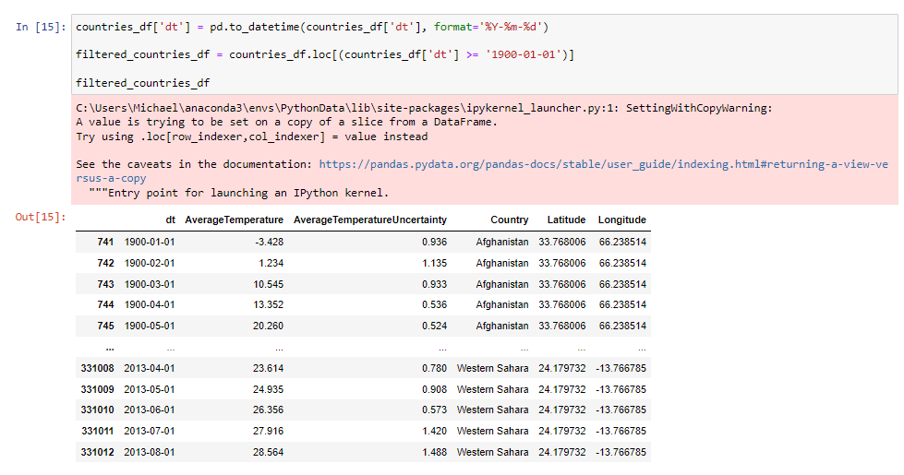
Data Cleaning
Original data: Our country specific dataset had over 500,000 rows of data.
ERD: After creating a relationship ERD with our data sources, the data was read into pandas to get an idea for what the data contained.

Slide 4
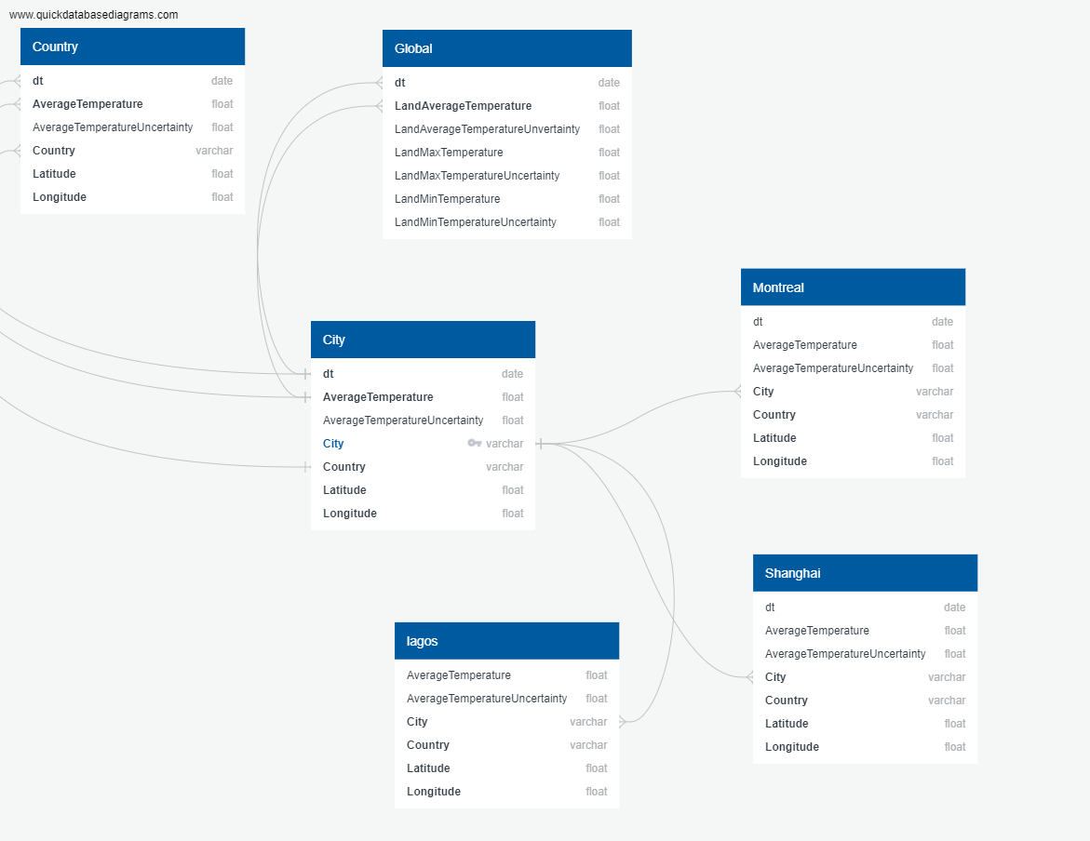
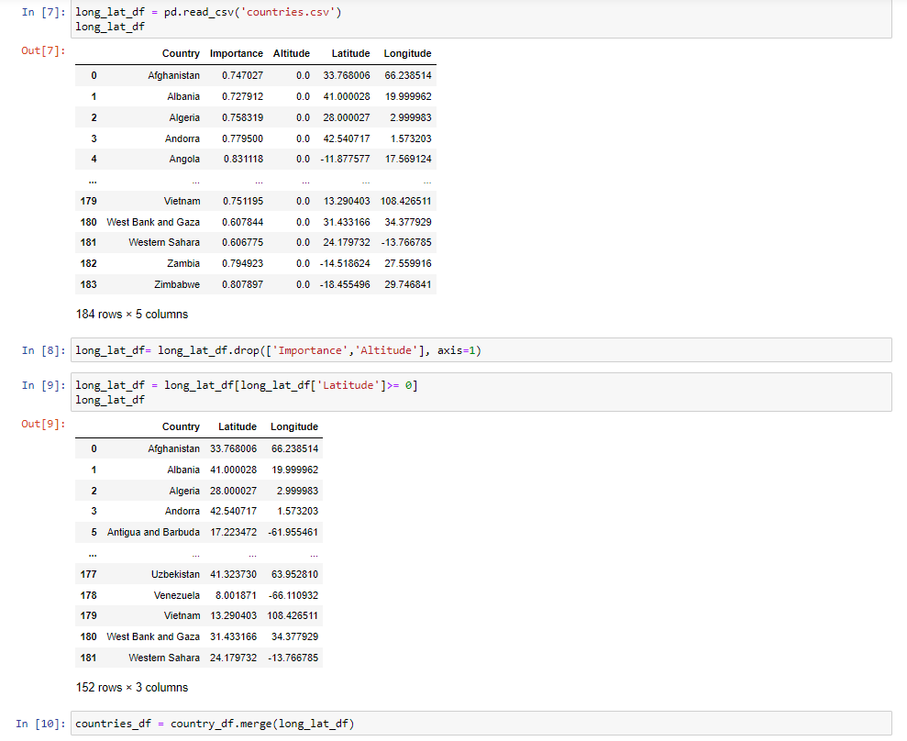
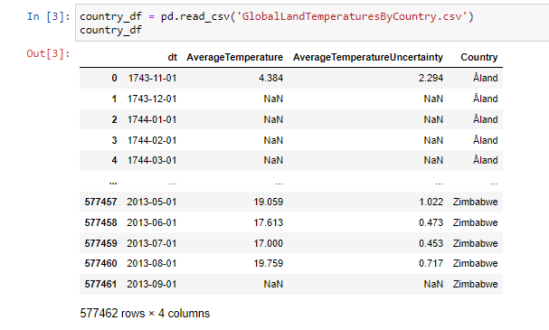
Data Cleaning
Not every dataset included everything that was needed for the analysis. We merged data together using pandas before putting it into the database
Every data frame had a date/time column(dt). In order to keep everything uniform we formatted each of these columns.

Slide 5
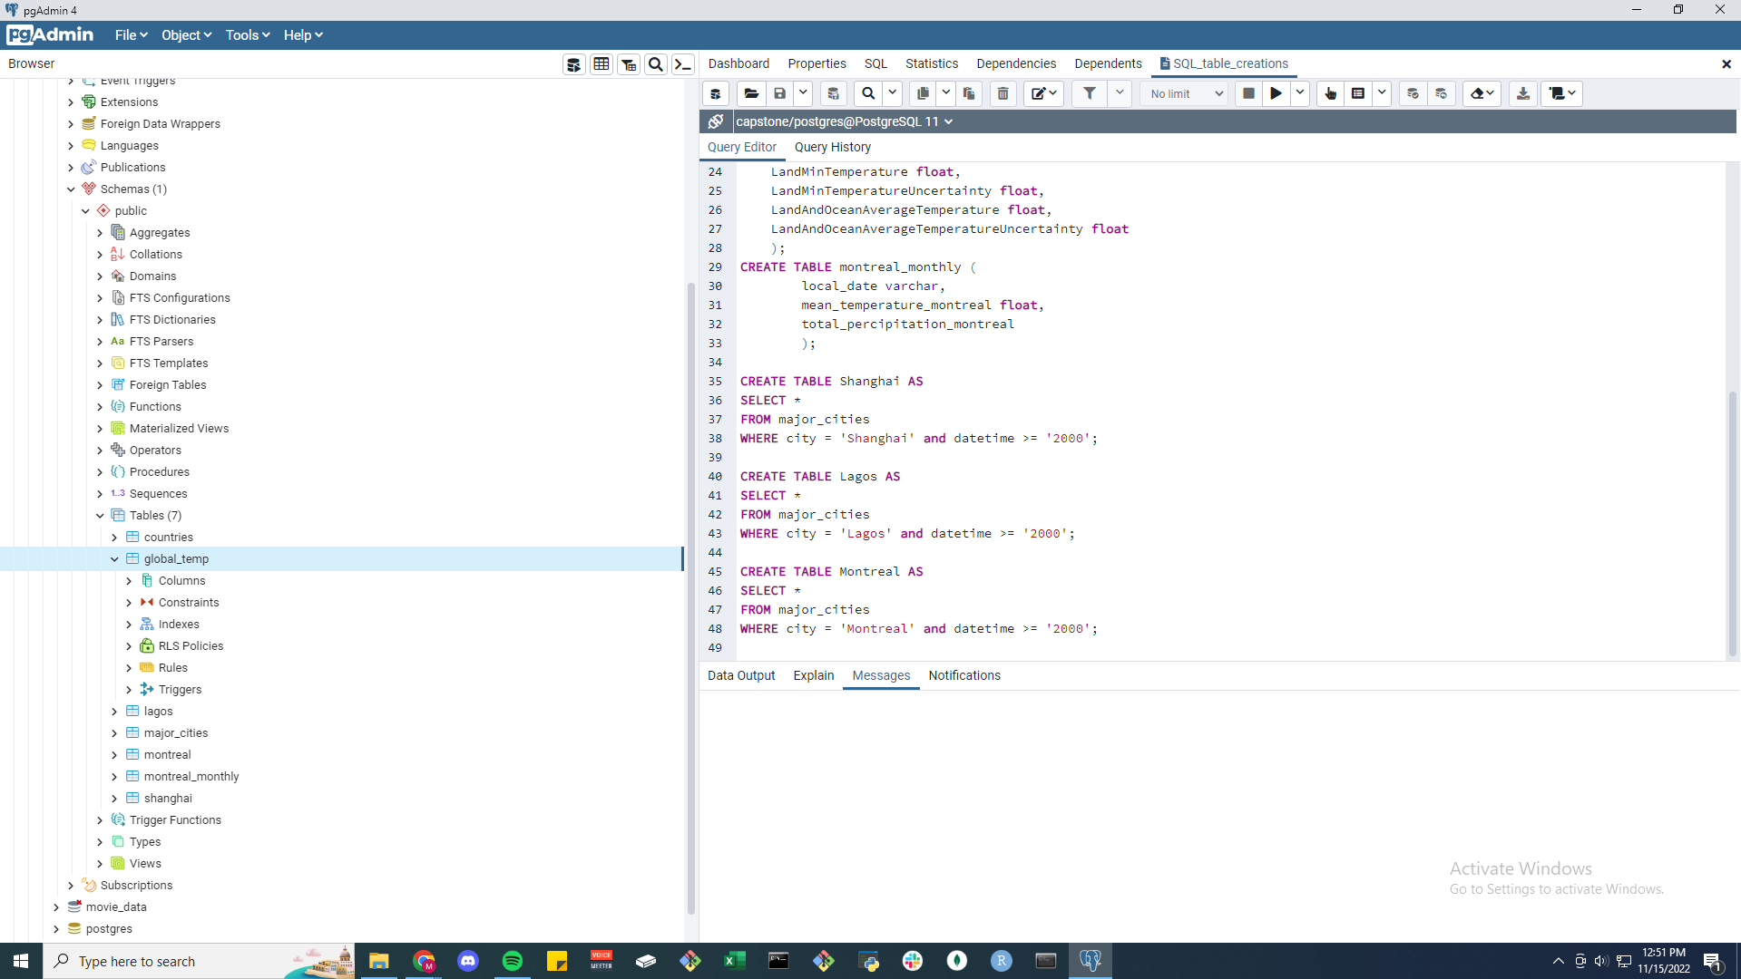
Data Cleaning
Key Takeaways:
Identified unnecessary data points
Narrowed the scope of the analysis
Created a workable database

Slide 6
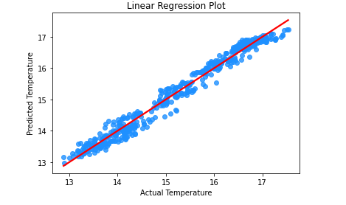
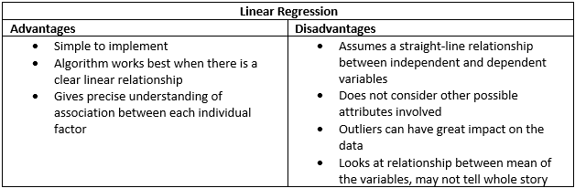
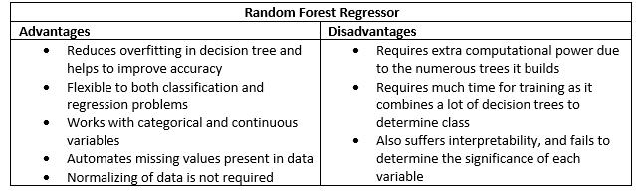
Supervised Machine Learning: Linear Regression and RFR
Preliminary feature engineering and preliminary feature selection, including decision-making process.
- Target variable - LandAndOceanAverageTemperature
- Predictor variables - LandAverageTemperature, LandMaxTemperature, and LandMinTemperature
Description of how data was split into train and test set
- 1992 rows of data after pre-processing training about 75% of the data, to then test on 25% of the data was the best split.

Slide 7
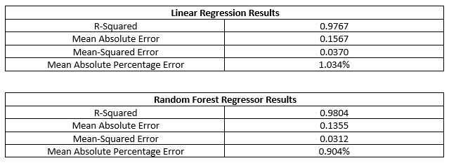
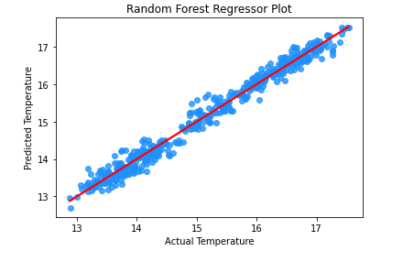
Model Analysis
We found that a random forest regressor model delivered the best results
Key Takeaways:
The random forest regressor model works well with the data given
There seems to be a positive relation between the predictor and target variables
The data has demonstrated that average temperature is steadily rising with no signs of decreasing anytime soon

Slide 8
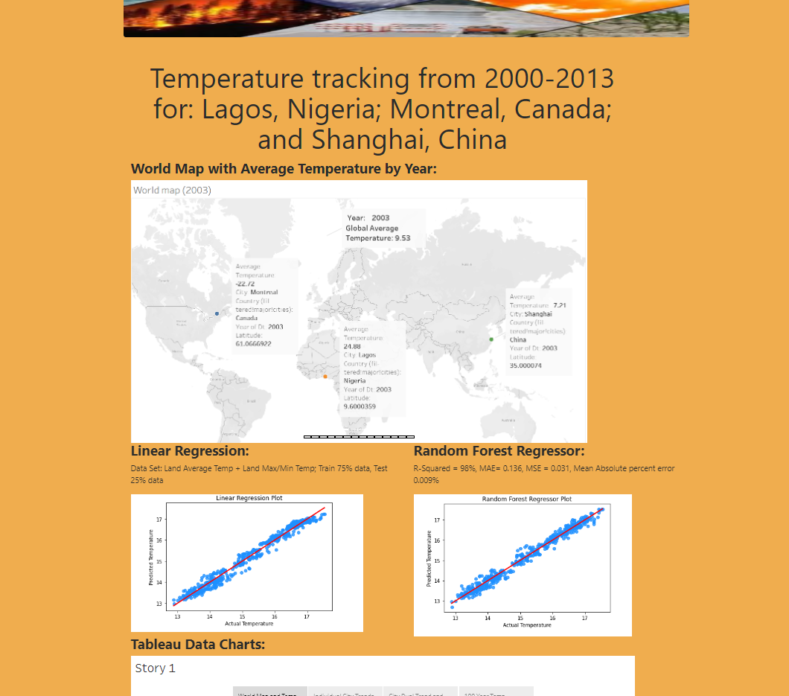
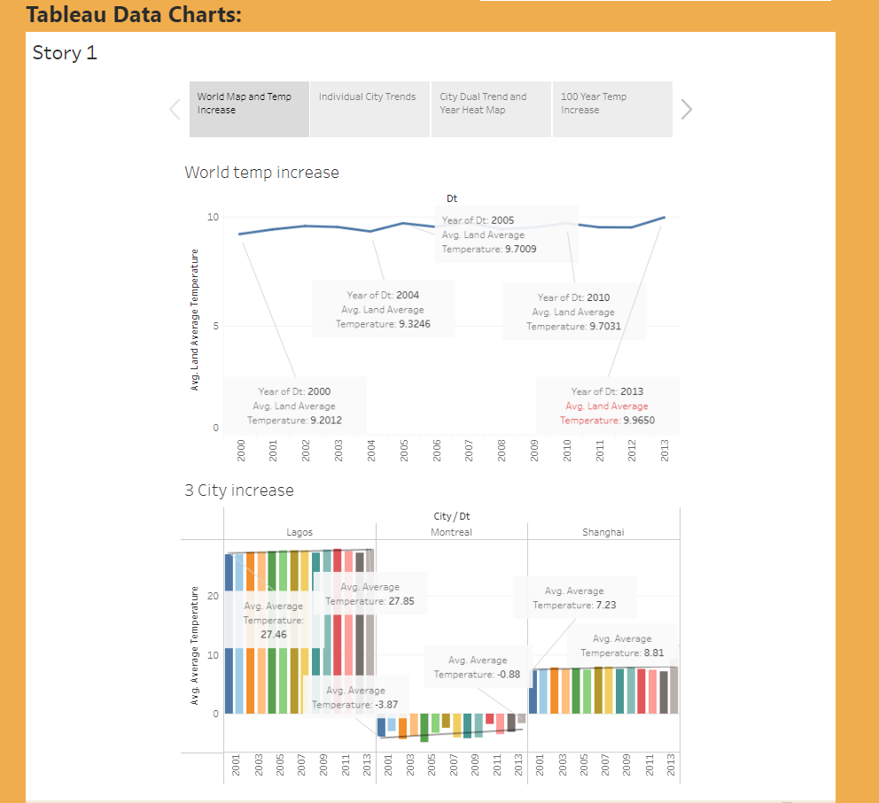
DASHBOARD
DASHBOARD

Slide 9
Summary:
1- Will the 2000-2013 weather trends indicate an increase in Earth surface temperature for Lagos, Nigeria; Shanghai, China and Montreal, Canada? Yes, accurate data representation for supporting an observed increase in overall global temperature.
2- What are the global increases in average temperature over time? Montreal +3.0%(4.2M), Lagos +0.4% increase (14.8M), Shanghai +1.5%(27.8M).
3- Do major cities impact climate change heavier? Population did not have an effect on Montreal +3.0%(4.2M), Lagos +0.4% increase (14.8M), Shanghai +1.5%(27.8M).
4- Does relation to the equator have an effect? No, average temperature was a slower increase over time period at equator location.
5- What model would best predict future climate change? The random forest regressor model seemed best to test for the data given. If the variables were to change, the model used may need to be revised.
Future data testing:
-Locate additional cities near ocean temperature affected bodies of water (large lakes or icebergs), would increase data available for more accurate predictive modeling.
-Utilize humidity as a measured data set to check for fluctuation in results
-Retest data for areas prone to impactful weather patterns (fires, hurricanes, tornados, floods)and see if they indicate increase temperature trends.
- Change data set to focus on landlocked locations (Nepal, Chad, Belarus, Bolivia) and or to see if large stand-alone continents (Australia, Antarctica, Greenland) show varied results
Suggestion: Continue to span the trending models out to years 2035, or 2050, or farther into the future to attempt to curb climate temperature increase contributing factors

Slide 10
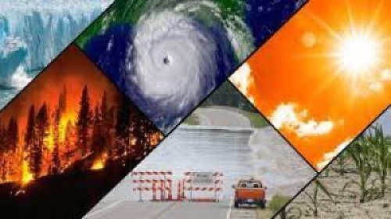
Resources
Kaggle Dataset: Climate Change: Earth Surface Temperature Data (https://www.kaggle.com/datasets/berkeleyearth/climate-change-earth-surface-temperature-data?resource=download) GlobalTemperatures.csv, GlobalTemperaturesByCountry.csv, GlobalTemperaturesByMajorCity.csv
Kaggle Dataset: Eighty years of Canadian climate data (https://www.kaggle.com/datasets/aturner374/eighty-years-of-canadian-climate-data)
SQLalchemy/pgAdmin
Jupyter Notebook
Tableau
Google Slides: https://docs.google.com/presentation/d/1-z85JcXZvhZiptGr7-FeUXKVXUaN76JUyfb_Ot5wezs/edit#slide=id.g1727fbf119b_0_35
Supervised Machine Learning

